Slide 1
Employee Data Analysis using Excel
STUDENT NAME: Lokesh V
REGISTER NO: 2213211042118
NM ID: unm13212213211042118
DEPARTMENT: B.Com CS
COLLEGE: Presidency College Chennai

Slide 2
PROJECT TITLE
Employee Work Location Analysis using Excel

Slide 3


AGENDA
Problem Statement
Project Overview
End Users
Our Solution and Proposition
Dataset Description
Modelling Approach
Results and Discussion
Conclusion
3/21/2024 Annual Review

Slide 4

PROBLEM STATEMENT
The employee work location helps to know the preference of employees, and the reason.
Every organization want to know the information about these things to increase the performance of other branches and concentrate on problems of less interest branches.

Slide 5

PROJECT OVERVIEW
The Project shows how many employees working in India and USA.
It clearly gives ideas that how many male and female working in the USA and India.
One can also get to know that total how many employees working in the particular location.

Slide 6

WHO ARE THE END USERS?
Organization:- The company can get to know where employees working more and there preference.
HR Manager:- The HR can know how many people working in there branches.
Workers:- Workers can get to know about how many people working in there branch and other branches.
Shareholders:- Shareholders of the company can use this data to invest in the company. They feel safe after knowing these informations.

Slide 7

OUR SOLUTION AND ITS VALUE PROPOSITION
Data organisation:- Organise the needed data in table formate like employee name, gender,work location,etc
Basic calculations:- Calculate the basic things such as male employees and female employees in particular locations.
Pivotal tables:- After calculating basic information make it into tabular format.
Data visualization:- After extracting details make it into graphs or diagrams helps visualise it properly.

Slide 8
Dataset Description
Employee Records
Work location
Gender
Employee ID
Performance analysis
Attendance

Slide 9

THE "WOW" IN OUR SOLUTION
Seen improvement in development of branches which have less interest of people
3/21/2024 Annual Review
9

Slide 10
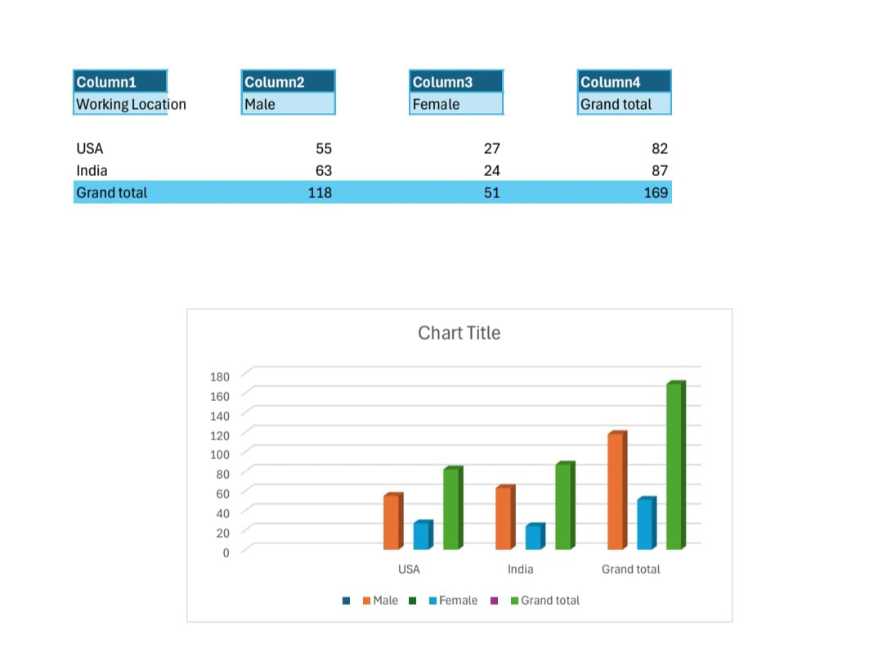
RESULTS
10

Slide 11
conclusion
The analysis provides valuable insights that can lead to
improved HR practices, better resource allocation, and
enhanced overall company performance.
Expand the analysis by incorporating more location-specific
variables like cost of living or regional job market trends to
refine the insights

